Slide 1
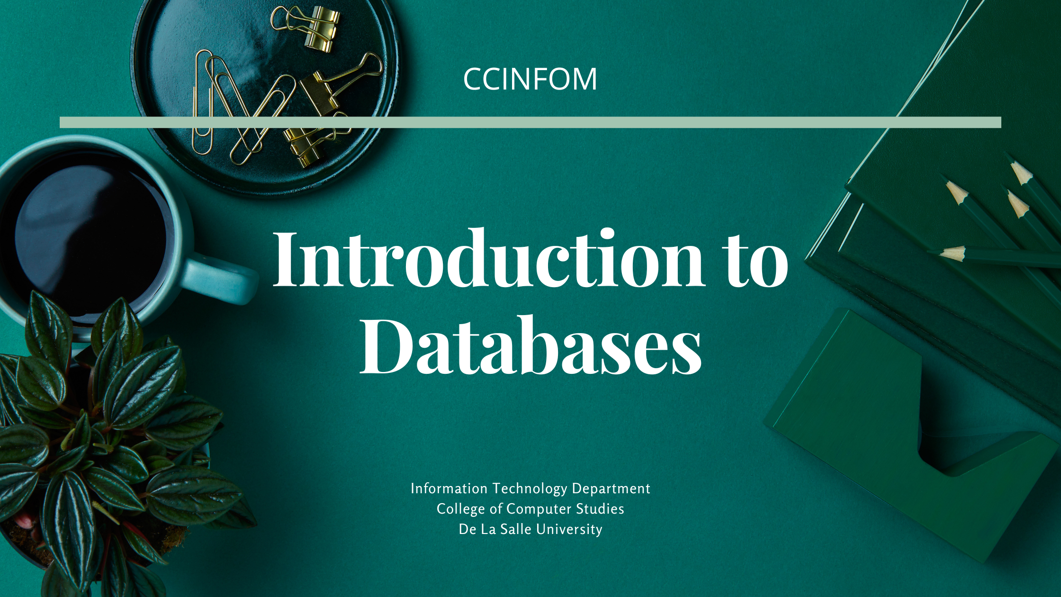

Slide 2




Opening Prayer
Let us remember that we are in the most holy presence of God.

Slide 3
Opening Prayer
Lord our God, Father of us all, grant that we may know something of you in our hearts. Each one of us is different, with his own particular needs, but we are all your children and should all become children of your Spirit. Then even in the difficulties of life, in the many struggles, temptations, and sorrows, we can keep up our courage and remain in the Spirit, who is victorious in every aspect of life.
https://www.plough.com/en/subscriptions/daily-prayer/may/daily-prayer-for-may-18

Slide 4
Opening Prayer
Protect and strengthen us on all our ways. We praise you for all you have done and for all the help you have given us.
AMEN.
https://www.plough.com/en/subscriptions/daily-prayer/may/daily-prayer-for-may-18

Slide 5
Opening Prayer
I will continue O my God to do all my actions for the love of You.
St. John Baptist de La Salle,
PRAY FOR US.
Live Jesus in our hearts,
FOREVER.

Slide 6


Slide 8

What did we cover in the last session?
Data Processing Basics
Issues with File-based Systems
Overview of Database Systems

Slide 9
Agenda
Understanding File-Based Systems
Understanding the issues WITH File-Based Systems
Understanding the basics of Database Systems
Notes:
This session aims at understanding what file-based systems are and their structure; understanding the issues of file-based systems; and understanding the basics of database systems and how they came about.

Slide 10

Should applications always use databases?
Information Technology Department
De La Salle University

Slide 11
Applications are driven by data & information
Games need to keep track of game scores
Some applications need to store data about the user’s configuration preferences
Business applications need to track data and information about business transactions

Slide 12
Applications are driven by data & information
Scientific applications need to store massive amounts of data collected from various scientific instruments
Applications installed in airplanes need to manage data in order to perform auto-pilot
Operating Systems (OS) need to keep track of data about the applications being installed on top of the OS

Slide 13
The GOOD things about files
It does not need connectivity to use it, it can reside within the same machine as the application
It is easier and faster to use (especially if it is a text file and if the content of the file is simple and small)
It is easy to update and maintain (especially if it is a text file)

Slide 14
When NOT to use files
When its contents are frequently shared to other applications on other machines, and by other users
When its contents are complex and will require a structure to organize the data
When its contents are frequently updated by other applications on other machines and an updated version of its contents are always expected
When its contents are just read by the application and it is not being updated

Slide 15
Database System Components

Slide 16
Database Systems
Database
DBMS
Database Application
Collection of Files
Not anymore known to the Application, nor to us, it’s the DBMS who only knows
Mode of Storing Data
Not anymore known to the Application, not to us, it’s the DBMS who only knows
Coded with data management functions
Collection
Storage
Processing (Types 1 to 4)
Distribution
Presentation
Uses a Data Model
To provide a conceptual/logical representation of how data is stored
Uses a Database Language
Notes:
The database application sends corresponding instructions to the DBMS on what to do with the data. In turn, it’s the DBMS which performs these instructions onto the linked database.
A database is still a collection of files, but it is no longer known to the application program, nor to use (regardless of whether we are programmers or end users). The database & it’s structure is only known to the DBMS.
Even the mode of storing data is only known to the DBMS.

Slide 17
Database Server (MYSQL Community Edition)
Physical Representation
DB1
DB2
DB3

Slide 18
Database Server (MYSQL Community Edition)
Logical Representation
Physical Representation
Database
Management
System (DBMS)
DB1
DB2
DB3

Slide 19
Database Server (MYSQL Community Edition)
Logical Representation
Physical Representation
Database
Management
System (DBMS)
DB1
Database Management Tool
(MYSQL Workbench)
DB2
SQL
DB3
Database Application
Programmed using a programming language (Java)

Slide 20
What roles in the entire database environment is this course designed for?
Database Architect - Designs the Databases, and uses SQL-DML to implement databases
Database Operator - Uses SQL-DDL-SELECT to generate reports
Database Developer - Uses SQL-DDL to enable applications to interact with databases
Not part of CCINFOM, but in subjects after CCINFOM
Database Developer - Uses advanced structures in DB to enhance data management capabilities, make queries run faster, and implement rules followed by the DB
Data Engineer - Uses advanced structures and methods in DB to implement ETL to populate Analytics DB
Notes:
You might be thinking, how will CCINFOM be useful in your future job? There is a reason information management is a core computing course. This course is designed for different roles in the entire database environment.
Other more advanced skills for database environment roles are developed in subjects that proceed CCINFOM:
Skills as a database developer are further enhanced as you…

Slide 21
MODULE 3 Database Architect (Designs DB)
NOT COVERED Database Administrator
(Implements, Installs & Manages DB)
MODULE 2 Database Operator
(Extract Ad-Hoc Reports from DB)
Database Server (MYSQL Community Edition)
Logical Representation
Physical Representation
Database
Management
System (DBMS)
DB1
Database Management Tool
(MYSQL Workbench)
DB2
SQL
DB3
Database Application
Programmed using a programming language (Java)
MODULE 4 Database Developer (Develops DB Application that uses the DB)

Slide 22
Concept Review

Slide 23
Concept Review
What are the components of a Database System?
Database
Database Management System (DBMS)
Database Application
Application written by developers using a programming language
Database Management tool used by DB Administrators, DB Architects, & DB Operators
Information Technology Department
De La Salle University
Notes:
You may pause this presentation first as you write your answer and resume when you are ready.

Slide 24
Concept Review
What are the components of a Database Server?
Database
Database Management System (DBMS)
Information Technology Department
De La Salle University
Notes:
You may pause this presentation first as you write your answer and resume when you are ready.

Slide 25
Concept Review
What are the top database server products in the market?
Oracle DB
MySQL DB
IBM DB/2
Information Technology Department
De La Salle University
Notes:
You may pause this presentation first as you write your answer and resume when you are ready.

Slide 26
Concept Review
When we interact with the database, do we see the physical representation of the data storage?
NO
We only see the logical representation of the storage
For relational databases, we see data storage as tables
The physical files where data is actually stored is managed by the DBMS for us.
Information Technology Department
De La Salle University
Notes:
You may pause this presentation first as you write your answer and resume when you are ready.

Slide 27
Concept Review
Do all the components of the database system need to be in one computer machine?
NO
The Database Server (database + DBMS) can be on a different machine with that of the database application
Information Technology Department
De La Salle University
Notes:
You may pause this presentation first as you write your answer and resume when you are ready.

Slide 28
Concept Review
Who are the technical professionals involved in the Database Environment?
Database Administrator
Database Architect
Database Operator
Database Applications Developer
Information Technology Department
De La Salle University
Notes:
You may pause this presentation first as you write your answer and resume when you are ready.

Slide 29
Concept Review
Why is there a need to have a database management tool?
Technical Professionals have the need to interactively interact with the database in the conduct of their work
Since they are knowledgeable in SQL (a technical computer language), they can interact directly with the Database Server.
Unlike non-technical users (e.g. enrollment clerk, registrar, president of the company) who need to use a database application for them to work on data.
Information Technology Department
De La Salle University
Notes:
You may pause this presentation first as you write your answer and resume when you are ready.

Slide 30
Concept Review
Are there other logical representations of data storage?
YES
But since almost ~85% of databases used worldwide is relational, this course is concentrating on learning the use of Relational Databases & RDBMS
Tables Relational Databases
Objects Object Databases
Trees Network Databases
Document Document Databases
Information Technology Department
De La Salle University
Notes:
You may pause this presentation first as you write your answer and resume when you are ready.

Slide 31
The Role of Applications in Data Management

Slide 32
Data Management Lifecycle
Collected or Created
Stored and Organized
Processed
Presented or Used
Shared or Distributed
Information Technology Department
De La Salle University

Slide 33
Data Management as a Core Module in Applications
Collecting Data (I)nput
Creating and Storing Data (C)reate
Accessing or Using Data (R)ead with or without Searching
Manipulating Data (U)pdate
Deleting Data (D)elete
Organizing Data (O)rganize or Sort
Processing Data (P)rocessing
Sharing Data (S)hare
Information Technology Department
De La Salle University

Slide 34
Records Management
When the management of data is in forms of records
Most applications perform records management or information management
Information Technology Department
De La Salle University

Slide 35
Issues about File-Based Systems
Application Software
Student Registration
Application Software
Enrollment
Application Software
Course Profile
Application Software
Student Org
Application Software
Dept Operation
Student
Enrollment
Courses
Student
Courses
Data became isolated
Proliferation of data redundancy and inconsistencies
How are the data related to each other?
Information Technology Department
De La Salle University

Slide 36
Issues about File-Based Systems
Application Software
Student Registration
Application Software
Enrollment
Application Software
Course Profile
Application Software
Student Org
Application Software
Dept Operation
Student
Enrollment
Courses
Student
Courses
Difficulties to relate data to another data
Security of data
Information Technology Department
De La Salle University

Slide 37
Issues about File-Based Systems
Application Software
Student Registration
Application Software
Enrollment
Application Software
Course Profile
Application Software
Student Org
Application Software
Dept Operation
Student
Enrollment
Courses
Student
Courses
Difficulties in sharing data among different applications
Adding new fields in the file structure will result to recoding of all programs using it even if the program is not going to use it
Information Technology Department
De La Salle University

Slide 38
Database Systems
Application Software
Student Registration
Application Software
Enrollment
Application Software
Course Profile
Application Software
Student Org
Application Software
Dept Operation
DBMS
Database
Student
Enrollment
Courses
Information Technology Department
De La Salle University

Slide 39
Data Processing
Type 1
Relating data together to form records
Type 2
Mathematical processing
Updating and deletion of data
Type 3
Relating records to each other
Type 4
Generation of reports
Generation of lists
Includes grouping, filtering, and sorting
Information Technology Department
De La Salle University

Slide 40
How do Database Systems Perform Data Management?
Collect | Store & Organize | Process | Share & Distribute | Present & Use
 | Sorting of Data in Storage | T1: Form Records T2: Mathematical Processing Update and Deletion of Records T3: Relating Records T4: Generation of Lists Generation of Reports Grouping, Filtering, and Sorting of Results
Information Technology Department
De La Salle University

Slide 41
Data Management in Database Systems
Data management activities are distributed to the components
Some are coded in the application
Some are sent to the DBMS to be performed by the DBMS
Characteristics/Dimensions of quality information are also distributed to the components
Some are ensured by the application
Some are ensured by the DBMS
Anyone who is learning about the DBMS must be conscious about the characteristics of quality information
Information Technology Department
De La Salle University

Slide 42
Dimensions of Quality Information
Accessible
Accurate
Complete
Economical
Flexible
Relevant
Reliable
Secure
Simple
Timely
Verifiable
Information Technology Department
De La Salle University
Notes:
Quality information should be
We will be discussing these characteristics one by one.

Slide 43
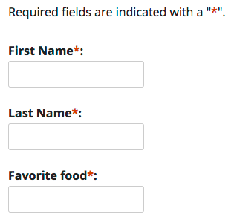
Examples of Distributed Responsibility to Ensure Quality Information
Characteristics | Database Application | DBMS
COMPLETE |  | Fields of tables are configured to be required fields e.g. When recording products information, the ID and Name is required, and the quantity should default to 0.
Information Technology Department
De La Salle University

Slide 44
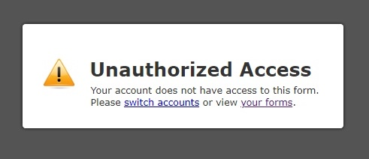
Examples of Distributed Responsibility to Ensure Quality Information
Characteristics | Database Application | DBMS
SECURED |  | Database users are restricted access to certain parts of the database e.g. An inventory user can only be allowed to see product information and not other information
Information Technology Department
De La Salle University

Slide 45
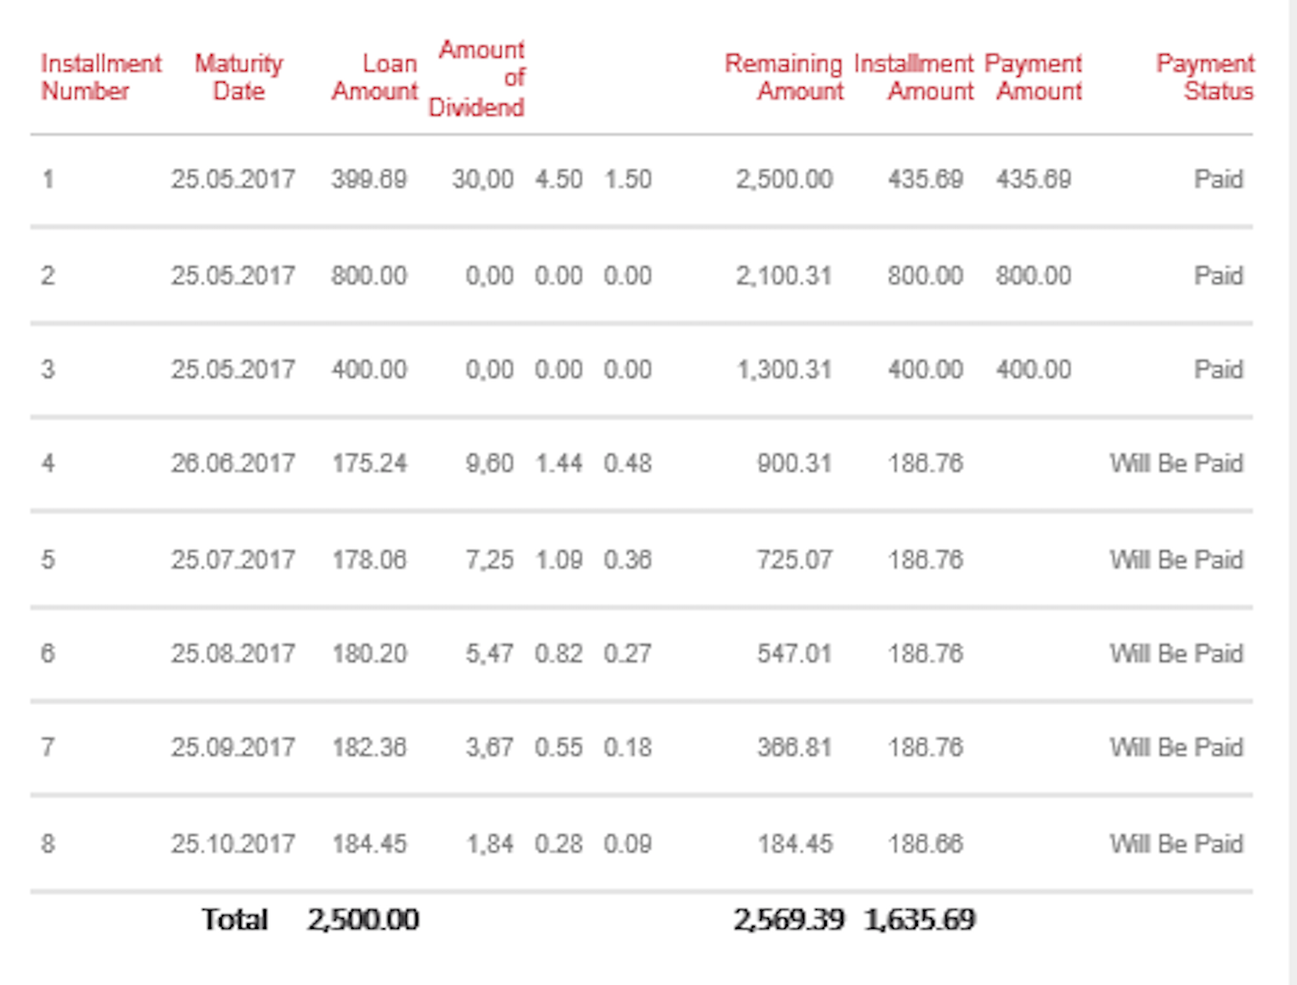
Examples of Distributed Responsibility to Ensure Quality Information
Characteristics | Database Application | DBMS
SIMPLE |  | SQL are written to produce results that are presentable e.g. Column names and sorted results; selection of appropriate fields to display

Slide 46
Examples of Distributed Responsibility to Ensure Quality Information
Characteristics | Database Application | DBMS
TIMELY | Software code is optimized | We write SQL statements that execute faster e.g. Use of appropriate SQL functions to optimize database search NOTE: Not an expectation yet in CCINFOM, but in Advance DB (BSCS), ITDBADM (BSIT) and ISINFOM (BSIS)
Information Technology Department
De La Salle University

Slide 47
Questions?
Information Technology Department
De La Salle University
Notes:
If there is an AnimoSpace discussion board created in your class for this topic, kindly post your questions there in order for the rest of the class to see the replies. Otherwise, you may reach out to your instructor through the communication channels provided.

Slide 48
Software Tools
PLEASE DOWNLOAD & INSTALL THE NECESSARY SOFTWARE TOOLS FOR THE COURSE
Information Technology Department
De La Salle University

Slide 49
References
Coronel, C. & Morris, S. (2017). Database systems: design, implementation, and management, 13th ed. Boston, MS: Cengage Learning.
Information Technology Department
De La Salle University

Slide 50

Notes:
That is the end of this session. Please check the AnimoSpace course for your section and keep yourself updated regarding other relevant materials or tasks on this topic. Thank you and keep safe always.

